Slide 1
SQL Server – Day 1

Slide 2
Introduction to SQL Server
SQL Server:
Is a data engine introduced by Microsoft.
Provides an environment used to create databases.
Allows secure and efficient storage and management of data.
Provides other components and services that support the business intelligence platform to generate reports and help in data analysis.
Notes:
2
Student already have learnt about type 2 SCDs in Module I. Therefore, you can start this topic by asking the following questions to students:
What are type 2 SCDs?
Given an example to explain type 2 SCDs.
This will recapitulate what they have learnt about type 2 SCD in Module 1.
Now explain the strategy to update the data into these dimension tables with help the example given in SG.
After explaining the examples, you can ask students to think of an example of a type 2 SCD and then tell the strategy to update the data into this dimension table.

Slide 3
SQL Server Components
What are the components of SQL Server?

Slide 4
SQL Server Components (Contd.)
The following figure displays the components of SQL Server.
Database Engine
Service Broker
Replication
Full-Text Search
Notification Services
Integration Services
Analysis Services
Reporting Services
Notes:
Explain the components of SQL Server as follows:
Database Engine: Provides support to store, query, process, and secure data on the database server
Integration Services: Allow you to gather and integrate data from various disparate data sources available in an organization
Analysis Services: Help in data analysis in a business intelligence application
Reporting Services: Provide support to generate comprehensive reports on data in database engine or in data warehouse

Slide 5
SQL Server Components (Contd.)
Database engine:
Provides support to store, query, process, and secure data on the database server.
Allows you to create and manage database objects, such as tables.
Provides the following background services:
Service broker
Replication
Full-text search
Notification services
Notes:
5
Student already have learnt about type 2 SCDs in Module I. Therefore, you can start this topic by asking the following questions to students:
What are type 2 SCDs?
Given an example to explain type 2 SCDs.
This will recapitulate what they have learnt about type 2 SCD in Module 1.
Now explain the strategy to update the data into these dimension tables with help the example given in SG.
After explaining the examples, you can ask students to think of an example of a type 2 SCD and then tell the strategy to update the data into this dimension table.

Slide 6
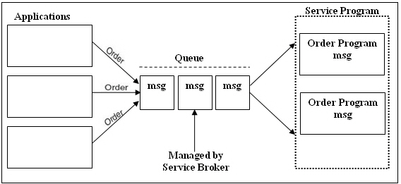
SQL Server Components (Contd.)
Service Broker:
Provides support for asynchronous communication between clients and the database server.
Enables reliable query processing.
The following figure shows an example of order processing system.
Notes:
6
Student already have learnt about type 2 SCDs in Module I. Therefore, you can start this topic by asking the following questions to students:
What are type 2 SCDs?
Given an example to explain type 2 SCDs.
This will recapitulate what they have learnt about type 2 SCD in Module 1.
Now explain the strategy to update the data into these dimension tables with help the example given in SG.
After explaining the examples, you can ask students to think of an example of a type 2 SCD and then tell the strategy to update the data into this dimension table.

Slide 7

SQL Server Components (Contd.)
Replication:
Allows you to copy and distribute data and database objects from one database server to another.
The following figure shows an example of order processing system.
Copies data to the distributor.
Distributes data to the subscriber.
Notes:
7
Student already have learnt about type 2 SCDs in Module I. Therefore, you can start this topic by asking the following questions to students:
What are type 2 SCDs?
Given an example to explain type 2 SCDs.
This will recapitulate what they have learnt about type 2 SCD in Module 1.
Now explain the strategy to update the data into these dimension tables with help the example given in SG.
After explaining the examples, you can ask students to think of an example of a type 2 SCD and then tell the strategy to update the data into this dimension table.

Slide 8
SQL Server Components (Contd.)
Full-text search:
Allows you to implement fast and intelligent search in large databases.
Notification services:
Allow you to generate and send notification messages to the users or administrators about any event.
Allow developers to build notification applications that send timely, personalized information updates, helping to enhance customer relationships.
Notes:
8
Student already have learnt about type 2 SCDs in Module I. Therefore, you can start this topic by asking the following questions to students:
What are type 2 SCDs?
Given an example to explain type 2 SCDs.
This will recapitulate what they have learnt about type 2 SCD in Module 1.
Now explain the strategy to update the data into these dimension tables with help the example given in SG.
After explaining the examples, you can ask students to think of an example of a type 2 SCD and then tell the strategy to update the data into this dimension table.

Slide 9
SQL Server Components (Contd.)
Integration services:
These services allow you to gather and integrate the varied data in a consistent format in a common database called the data warehouse.
A data warehouse is similar to a physical warehouse that stores raw material or products for further distribution.
The SQL Server Integration Services (SSIS) Import and Export Wizard helps you to complete the process of selecting the data source, the destination, and the objects that will be transferred to create a data warehouse.
Notes:
9
Student already have learnt about type 2 SCDs in Module I. Therefore, you can start this topic by asking the following questions to students:
What are type 2 SCDs?
Given an example to explain type 2 SCDs.
This will recapitulate what they have learnt about type 2 SCD in Module 1.
Now explain the strategy to update the data into these dimension tables with help the example given in SG.
After explaining the examples, you can ask students to think of an example of a type 2 SCD and then tell the strategy to update the data into this dimension table.

Slide 10
SQL Server Components (Contd.)
Analysis services:
These services help in data analysis in a BI application.
Microsoft SQL Server Analysis Services (SSAS):
Provides Online Analytical Processing (OLAP) for BI applications.
Notes:
10
Student already have learnt about type 2 SCDs in Module I. Therefore, you can start this topic by asking the following questions to students:
What are type 2 SCDs?
Given an example to explain type 2 SCDs.
This will recapitulate what they have learnt about type 2 SCD in Module 1.
Now explain the strategy to update the data into these dimension tables with help the example given in SG.
After explaining the examples, you can ask students to think of an example of a type 2 SCD and then tell the strategy to update the data into this dimension table.

Slide 11
SQL Server Components (Contd.)
Reporting services:
These services provide support to generate complete reports on data in the database engine or in the data warehouse.
These services provide secure and restricted access to these reports.
Microsoft SQL Server Reporting Services (SSRS):
Helps in creating Web-based reports that is based on the content stored in a variety of data sources.
Notes:
11
Student already have learnt about type 2 SCDs in Module I. Therefore, you can start this topic by asking the following questions to students:
What are type 2 SCDs?
Given an example to explain type 2 SCDs.
This will recapitulate what they have learnt about type 2 SCD in Module 1.
Now explain the strategy to update the data into these dimension tables with help the example given in SG.
After explaining the examples, you can ask students to think of an example of a type 2 SCD and then tell the strategy to update the data into this dimension table.

Slide 12
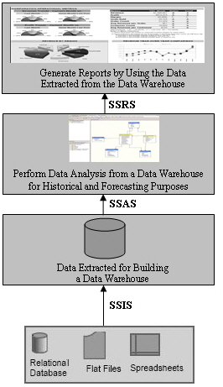
SQL Server Components (Contd.)
The following figure shows the usage of the various SQL Server core components in a BI application.
Notes:
12
Student already have learnt about type 2 SCDs in Module I. Therefore, you can start this topic by asking the following questions to students:
What are type 2 SCDs?
Given an example to explain type 2 SCDs.
This will recapitulate what they have learnt about type 2 SCD in Module 1.
Now explain the strategy to update the data into these dimension tables with help the example given in SG.
After explaining the examples, you can ask students to think of an example of a type 2 SCD and then tell the strategy to update the data into this dimension table.

Slide 13
SQL Server Integration with the .NET Framework
Microsoft SQL Server is integrated with the .NET Framework.
Notes:
13
Student already have learnt about type 2 SCDs in Module I. Therefore, you can start this topic by asking the following questions to students:
What are type 2 SCDs?
Given an example to explain type 2 SCDs.
This will recapitulate what they have learnt about type 2 SCD in Module 1.
Now explain the strategy to update the data into these dimension tables with help the example given in SG.
After explaining the examples, you can ask students to think of an example of a type 2 SCD and then tell the strategy to update the data into this dimension table.

Slide 14
SQL Server Integration with the .NET Framework (Contd.)
The following figure shows the integration of SQL Server with the .NET Framework.
.NET Framework
Database Engine
Service Broker
Replication
Full-Text Search
Notification Services
Integration Services
Analysis Services
Reporting Services
Notes:
You can summarize the session by running through the summary given in SG.
In addition, you can also ask students summarize what they have learnt in this session.

Slide 15
SQL Server Integration with the .NET Framework (Contd.)
The .NET Framework:
Is an environment used to build, deploy, and run business applications.
Has its own collection of services and classes.
Consists of the following components:
Development tools and languages
Base class library
Common Language Runtime (CLR)
Notes:
You can summarize the session by running through the summary given in SG.
In addition, you can also ask students summarize what they have learnt in this session.

Slide 16
SQL Server Integration with the .NET Framework (Contd.)
Development tools and languages:
Are used to create the interface for the Windows forms, Web forms, and console applications.
Base class library:
Provides classes that can be used in the code to accomplish a range of common programming tasks, such as:
String management
Data collection
Database connectivity
File access
Notes:
You can summarize the session by running through the summary given in SG.
In addition, you can also ask students summarize what they have learnt in this session.

Slide 17
SQL Server Integration with the .NET Framework (Contd.)
CLR:
Provides an environment for the application to run.
Provides the following features:
Automatic memory management
Standard type system
Language interoperability
Platform independence
Security management
Notes:
You can summarize the session by running through the summary given in SG.
In addition, you can also ask students summarize what they have learnt in this session.

Slide 18
Features of SQL Server
SQL Server provides the following features:
Built-in support for Extensible Markup Language (XML) data
CLR integration
Scalability
Service-oriented architecture
Support for Web services
High level of security
High availability
Support for data migration and analysis
Intellisense
Policy-based management
Resource governor

Slide 19
SQL
Is the core language used to store, access, and modify data.
Can be categorized as:
Data Definition Language (DDL):
Is used to define the database, data types, structures, and constraints on the data.
Data Manipulation Language (DML):
Is used to manipulate the data in the database objects.
Data Control Language (DCL):
Is used to control the data access in the database.
Data Query Language (DQL):
Is used to query data from the database objects.
Notes:
Emphasize on the fact that most DBMS have created customized versions of the SQL language. For example, Transact-SQL (T-SQL) is a scripting language used on the SQL Server for programming. Alternatively, PL-SQL is used for programming in Oracle. T-SQL confirms to the ANSI SQL-92 standard published by ANSI and ISO in the year 1992.

Slide 20
SQL (Contd.)
Some of the DDL statements are:
CREATE
ALTER
DROP
Some of the DML statements are:
INSERT
UPDATE
DELETE
Some of the DCL statements are:
GRANT
REVOKE
Notes:
Emphasize on the fact that most DBMS have created customized versions of the SQL language. For example, Transact-SQL (T-SQL) is a scripting language used on the SQL Server for programming. Alternatively, PL-SQL is used for programming in Oracle. T-SQL confirms to the ANSI SQL-92 standard published by ANSI and ISO in the year 1992.

Slide 21
Just a minute
Which of the following features of SQL Server allows the developers to implement their programming logic in any language supported by the .NET Framework?
Support for data migration
High availability
CLR integration
Scalability
Answer:
3. CLR integration

Slide 22
Identifying SQL Server Tools
Before you start working on SQL Server, it is important to identify the various tools and their features provided by SQL Server.
Notes:
22
Student already have learnt about type 2 SCDs in Module I. Therefore, you can start this topic by asking the following questions to students:
What are type 2 SCDs?
Given an example to explain type 2 SCDs.
This will recapitulate what they have learnt about type 2 SCD in Module 1.
Now explain the strategy to update the data into these dimension tables with help the example given in SG.
After explaining the examples, you can ask students to think of an example of a type 2 SCD and then tell the strategy to update the data into this dimension table.

Slide 23
SQL Server Management Studio
Is a powerful tool associated with SQL Server.
Provides a simple and integrated environment for developing and managing the SQL Server database objects.
Notes:
Student already have learnt about type 2 SCDs in Module I. Therefore, you can start this topic by asking the following questions to students:
What are type 2 SCDs?
Given an example to explain type 2 SCDs.
This will recapitulate what they have learnt about type 2 SCD in Module 1.
Now explain the strategy to update the data into these dimension tables with help the example given in SG.
After explaining the examples, you can ask students to think of an example of a type 2 SCD and then tell the strategy to update the data into this dimension table.

Slide 24
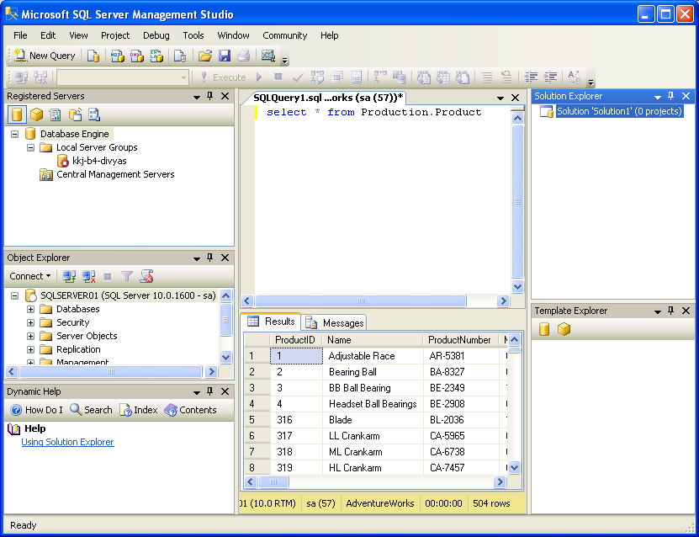
SQL Server Management Studio (Contd.)
The following figure shows the SQL Server Management Studio interface.
Solution Explorer
Registered Servers
Query Editor
Object Explorer
Template Explorer
Dynamic Help
Let us see how to open SQL Server Management Studio.
Notes:
Student already have learnt about type 2 SCDs in Module I. Therefore, you can start this topic by asking the following questions to students:
What are type 2 SCDs?
Given an example to explain type 2 SCDs.
This will recapitulate what they have learnt about type 2 SCD in Module 1.
Now explain the strategy to update the data into these dimension tables with help the example given in SG.
After explaining the examples, you can ask students to think of an example of a type 2 SCD and then tell the strategy to update the data into this dimension table.

Slide 25
SQL Server Business Intelligence Development Studio
Is a tool that provides an environment to develop business intelligence solutions.
Contains templates, tools, and wizards to work with objects that you can use to create business intelligence solutions.
Helps build the following types of solutions:
Data integration
Data analysis
Data reporting
Notes:
Student already have learnt about type 2 SCDs in Module I. Therefore, you can start this topic by asking the following questions to students:
What are type 2 SCDs?
Given an example to explain type 2 SCDs.
This will recapitulate what they have learnt about type 2 SCD in Module 1.
Now explain the strategy to update the data into these dimension tables with help the example given in SG.
After explaining the examples, you can ask students to think of an example of a type 2 SCD and then tell the strategy to update the data into this dimension table.

Slide 26
Database Engine Tuning Advisor
Helps database administrators to analyze and tune the performance of the server.
Provides recommendations to add, remove, or modify database objects, such as indexes or indexed views to improve performance.
Notes:
Student already have learnt about type 2 SCDs in Module I. Therefore, you can start this topic by asking the following questions to students:
What are type 2 SCDs?
Given an example to explain type 2 SCDs.
This will recapitulate what they have learnt about type 2 SCD in Module 1.
Now explain the strategy to update the data into these dimension tables with help the example given in SG.
After explaining the examples, you can ask students to think of an example of a type 2 SCD and then tell the strategy to update the data into this dimension table.

Slide 27
SQL Server Configuration Manager
Helps the database administrators to manage the services associated with SQL Server.
Allows you to manage the network connectivity configuration from the SQL Server client computers.
Allows you to specify the protocols through which the client computers can connect to the server.
Notes:
Student already have learnt about type 2 SCDs in Module I. Therefore, you can start this topic by asking the following questions to students:
What are type 2 SCDs?
Given an example to explain type 2 SCDs.
This will recapitulate what they have learnt about type 2 SCD in Module 1.
Now explain the strategy to update the data into these dimension tables with help the example given in SG.
After explaining the examples, you can ask students to think of an example of a type 2 SCD and then tell the strategy to update the data into this dimension table.

Slide 28
SQL Server Profiler
Helps in monitoring the events, such as login connections, execution of DML statements, stored procedures, batches, and security permission checks that are generated within an instance of a database engine.
Provides an in depth view of the query submission, access of the database against the queries, and return of results after processing of queries.

Slide 29
Retrieving Data
To retrieve data, you first need to understand the various data types used in SQL Server.
Notes:
29
Student already have learnt about type 2 SCDs in Module I. Therefore, you can start this topic by asking the following questions to students:
What are type 2 SCDs?
Given an example to explain type 2 SCDs.
This will recapitulate what they have learnt about type 2 SCD in Module 1.
Now explain the strategy to update the data into these dimension tables with help the example given in SG.
After explaining the examples, you can ask students to think of an example of a type 2 SCD and then tell the strategy to update the data into this dimension table.

Slide 30
Identifying Data Types
Data types:
Specify the type of data that an object can contain.
Can be associated with each column, local variable, or an expression defined in the database.
You can store the following types of data in a database:
Structured data
Semi-structured data
Unstructured data
Notes:
You can summarize the session by running through the summary given in SG.
In addition, you can also ask students summarize what they have learnt in this session.

Slide 31
Identifying Data Types (Contd.)
The following table lists some of the data types supported by SQL Server.
Data type | Range | Used to store | Storage (Bytes)
int | –2^31 (–2,147,483,648) to 2^31–1 (2,147,483,647) | Integer data (whole numbers) | 4
float | –1.79E+308 to –2.23E–308, 0 and 2.23E–308 to 1.79E+308 | Floating precision data | 4 to 8
money | –922,337,203,685,477.5808 to 922,337,203,685,477.5807 | Monetary data | 8
char(n) | n characters, where n can be 1 to 8000 | Fixed length character data | n
varchar(n) | n characters, where n can be 1 to 8000 | Variable length character data | n+2
xml | xml instances and xml type variables | Store and return xml values | Variable size
Geometry | Two-dimensional data | Geometrical shapes, such as points, lines, and polygon | Variable size
geography | Ellipsoidal data | Geographical data, such as the latitude and longitude coordinates that represent points, lines, and polygons on the earth’s surface | Variable size
Notes:
You can summarize the session by running through the summary given in SG.
In addition, you can also ask students summarize what they have learnt in this session.

Slide 32
Retrieving Specific Attributes
The SELECT statement is used for accessing and retrieving data from a database.
Syntax:
SELECT [ALL | DISTINCT] select_column_list [INTO [new_table_name]] [FROM {table_name | view_name} [WHERE search_condition]
Notes:
You can summarize the session by running through the summary given in SG.
In addition, you can also ask students summarize what they have learnt in this session.

Slide 33
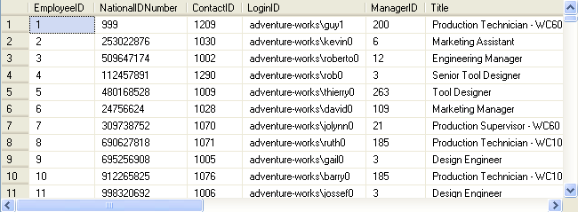
Retrieving Specific Attributes (Contd.)
To display all the details of employees, you can use the following query:
SELECT * FROM HumanResources.Employee
Output
Notes:
Student already have learnt about type 2 SCDs in Module I. Therefore, you can start this topic by asking the following questions to students:
What are type 2 SCDs?
Given an example to explain type 2 SCDs.
This will recapitulate what they have learnt about type 2 SCD in Module 1.
Now explain the strategy to update the data into these dimension tables with help the example given in SG.
After explaining the examples, you can ask students to think of an example of a type 2 SCD and then tell the strategy to update the data into this dimension table.

Slide 34
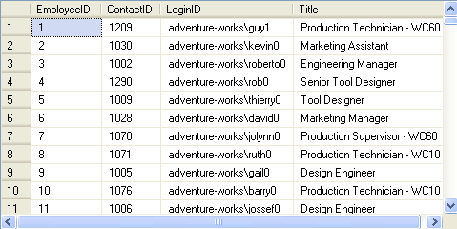
Retrieving Specific Attributes (Contd.)
To view specific details, you can specify the column names in the SELECT statement, as shown in the following query:
SELECT EmployeeID, ContactID, LoginID, Title
FROM HumanResources.Employee
Output
Notes:
Student already have learnt about type 2 SCDs in Module I. Therefore, you can start this topic by asking the following questions to students:
What are type 2 SCDs?
Given an example to explain type 2 SCDs.
This will recapitulate what they have learnt about type 2 SCD in Module 1.
Now explain the strategy to update the data into these dimension tables with help the example given in SG.
After explaining the examples, you can ask students to think of an example of a type 2 SCD and then tell the strategy to update the data into this dimension table.

Slide 35
Retrieving Specific Attributes (Contd.)
Customizing the display:
Consider the following example that displays the Department ID and Department Names from the Department table of the AdventureWorks database.
The report should contain column headings different from those given in the table, as shown in the following figure.
Department Number | Department Name
Notes:
Student already have learnt about type 2 SCDs in Module I. Therefore, you can start this topic by asking the following questions to students:
What are type 2 SCDs?
Given an example to explain type 2 SCDs.
This will recapitulate what they have learnt about type 2 SCD in Module 1.
Now explain the strategy to update the data into these dimension tables with help the example given in SG.
After explaining the examples, you can ask students to think of an example of a type 2 SCD and then tell the strategy to update the data into this dimension table.

Slide 36
Retrieving Specific Attributes (Contd.)
You can write the query in the following ways:
SELECT 'Department Number'= DepartmentID, 'Department Name'= Name FROM HumanResources.Department
SELECT DepartmentID 'Department Number', Name 'Department Name' FROM HumanResources.Department
SELECT DepartmentID AS 'Department Number', Name AS 'Department Name' FROM HumanResources.Department
OR
OR
Notes:
Student already have learnt about type 2 SCDs in Module I. Therefore, you can start this topic by asking the following questions to students:
What are type 2 SCDs?
Given an example to explain type 2 SCDs.
This will recapitulate what they have learnt about type 2 SCD in Module 1.
Now explain the strategy to update the data into these dimension tables with help the example given in SG.
After explaining the examples, you can ask students to think of an example of a type 2 SCD and then tell the strategy to update the data into this dimension table.

Slide 37
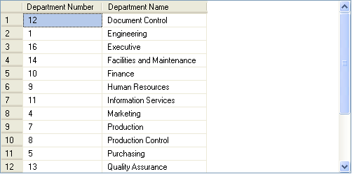
Retrieving Specific Attributes (Contd.)
The SQL Server will display the same output for all the preceding queries, as shown in the following figure.
Notes:
Student already have learnt about type 2 SCDs in Module I. Therefore, you can start this topic by asking the following questions to students:
What are type 2 SCDs?
Given an example to explain type 2 SCDs.
This will recapitulate what they have learnt about type 2 SCD in Module 1.
Now explain the strategy to update the data into these dimension tables with help the example given in SG.
After explaining the examples, you can ask students to think of an example of a type 2 SCD and then tell the strategy to update the data into this dimension table.

Slide 38
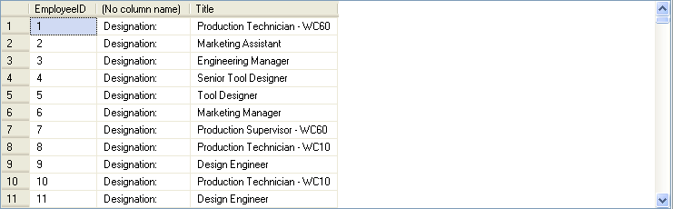
Retrieving Specific Attributes (Contd.)
Literals are string values that are enclosed in single quotes and added to the SELECT statement.
The following SQL query retrieves the employee ID and their titles from the Employee table along with a literal ‘Designation’:
SELECT EmployeeID, 'Designation: ', Title
FROM HumanResources.Employee
Output
Notes:
Student already have learnt about type 2 SCDs in Module I. Therefore, you can start this topic by asking the following questions to students:
What are type 2 SCDs?
Given an example to explain type 2 SCDs.
This will recapitulate what they have learnt about type 2 SCD in Module 1.
Now explain the strategy to update the data into these dimension tables with help the example given in SG.
After explaining the examples, you can ask students to think of an example of a type 2 SCD and then tell the strategy to update the data into this dimension table.

Slide 39
Retrieving Specific Attributes (Contd.)
Concatenating the text values in the output:
The concatenation operator is used to concatenate string expressions and is represented by the + sign.
To concatenate two strings, you can use the following query:
SELECT 'snow' + 'ball'
Output
snowball
Notes:
Student already have learnt about type 2 SCDs in Module I. Therefore, you can start this topic by asking the following questions to students:
What are type 2 SCDs?
Given an example to explain type 2 SCDs.
This will recapitulate what they have learnt about type 2 SCD in Module 1.
Now explain the strategy to update the data into these dimension tables with help the example given in SG.
After explaining the examples, you can ask students to think of an example of a type 2 SCD and then tell the strategy to update the data into this dimension table.

Slide 40
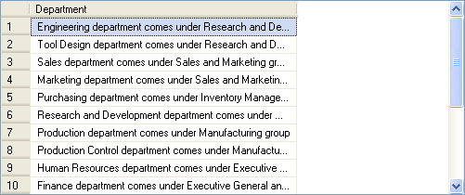
Retrieving Specific Attributes (Contd.)
The following SQL query concatenates the data of the Name and GroupName columns of the Department table into a single column:
SELECT Name + ' department comes under ‘ + GroupName + ' group' AS Department FROM HumanResources.Department
Output
Notes:
Student already have learnt about type 2 SCDs in Module I. Therefore, you can start this topic by asking the following questions to students:
What are type 2 SCDs?
Given an example to explain type 2 SCDs.
This will recapitulate what they have learnt about type 2 SCD in Module 1.
Now explain the strategy to update the data into these dimension tables with help the example given in SG.
After explaining the examples, you can ask students to think of an example of a type 2 SCD and then tell the strategy to update the data into this dimension table.

Slide 41
Retrieving Specific Attributes (Contd.)
Calculating column values:
Arithmetic operators are used to perform mathematical operations, such as addition, subtraction, division, and multiplication, on numeric columns or on numeric constants.
SQL Server supports the following arithmetic operations:
+ (for addition)
- (for subtraction)
/ (for division)
* (for multiplication)
% (for modulo)
Notes:
Student already have learnt about type 2 SCDs in Module I. Therefore, you can start this topic by asking the following questions to students:
What are type 2 SCDs?
Given an example to explain type 2 SCDs.
This will recapitulate what they have learnt about type 2 SCD in Module 1.
Now explain the strategy to update the data into these dimension tables with help the example given in SG.
After explaining the examples, you can ask students to think of an example of a type 2 SCD and then tell the strategy to update the data into this dimension table.

Slide 42
Retrieving Specific Attributes (Contd.)
The following SQL query retrieves the per day rate of the employees from the EmployeePayHistory table: SELECT EmployeeID, Rate,
Per_Day_Rate = 8 * Rate
FROM HumanResources.EmployeePayHistory
Rate is multiplied by 8, assuming that an employee works for eight hours in a day.
Notes:
Student already have learnt about type 2 SCDs in Module I. Therefore, you can start this topic by asking the following questions to students:
What are type 2 SCDs?
Given an example to explain type 2 SCDs.
This will recapitulate what they have learnt about type 2 SCD in Module 1.
Now explain the strategy to update the data into these dimension tables with help the example given in SG.
After explaining the examples, you can ask students to think of an example of a type 2 SCD and then tell the strategy to update the data into this dimension table.

Slide 43
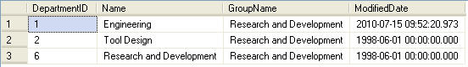
Retrieving Selected Rows
Selected rows can be retrieved using the WHERE clause in the SELECT statement.
The following SQL query retrieves the department details from the Department table, where the group name is Research and Development:
SELECT * FROM HumanResources.Department
WHERE GroupName = 'Research and Development'
Output
Notes:
Student already have learnt about type 2 SCDs in Module I. Therefore, you can start this topic by asking the following questions to students:
What are type 2 SCDs?
Given an example to explain type 2 SCDs.
This will recapitulate what they have learnt about type 2 SCD in Module 1.
Now explain the strategy to update the data into these dimension tables with help the example given in SG.
After explaining the examples, you can ask students to think of an example of a type 2 SCD and then tell the strategy to update the data into this dimension table.

Slide 44
Retrieving Selected Rows (Contd.)
Comparison operators:
Test for similarity between two expressions.
Allow row retrieval from a table based on the condition specified in the WHERE clause.
Cannot be used on text, ntext, or image data type expressions.
Syntax:
SELECT column_list
FROM table_name
WHERE expression1 comparison_operator expression2
Notes:
Student already have learnt about type 2 SCDs in Module I. Therefore, you can start this topic by asking the following questions to students:
What are type 2 SCDs?
Given an example to explain type 2 SCDs.
This will recapitulate what they have learnt about type 2 SCD in Module 1.
Now explain the strategy to update the data into these dimension tables with help the example given in SG.
After explaining the examples, you can ask students to think of an example of a type 2 SCD and then tell the strategy to update the data into this dimension table.

Slide 45
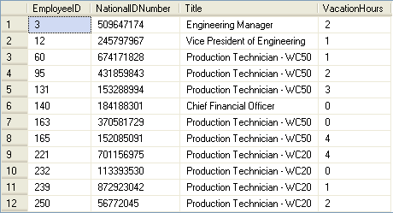
Retrieving Selected Rows (Contd.)
The following SQL query retrieves records from the Employee table where the vacation hour is less than 5:
SELECT EmployeeID, NationalIDNumber, Title, VacationHours FROM HumanResources.Employee WHERE VacationHours < 5
Output
Notes:
Student already have learnt about type 2 SCDs in Module I. Therefore, you can start this topic by asking the following questions to students:
What are type 2 SCDs?
Given an example to explain type 2 SCDs.
This will recapitulate what they have learnt about type 2 SCD in Module 1.
Now explain the strategy to update the data into these dimension tables with help the example given in SG.
After explaining the examples, you can ask students to think of an example of a type 2 SCD and then tell the strategy to update the data into this dimension table.

Slide 46
Retrieving Selected Rows (Contd.)
Logical operators:
Are used in the SELECT statement to retrieve records based on one or more conditions.
Are of the following types:
OR
AND
NOT
Syntax:
SELECT column_list
FROM table_name
WHERE conditional_expression1 {AND/OR} [NOT]
conditional_expression2
Notes:
Student already have learnt about type 2 SCDs in Module I. Therefore, you can start this topic by asking the following questions to students:
What are type 2 SCDs?
Given an example to explain type 2 SCDs.
This will recapitulate what they have learnt about type 2 SCD in Module 1.
Now explain the strategy to update the data into these dimension tables with help the example given in SG.
After explaining the examples, you can ask students to think of an example of a type 2 SCD and then tell the strategy to update the data into this dimension table.

Slide 47
Retrieving Selected Rows (Contd.)
For example:
SELECT * FROM HumanResources.Department
WHERE GroupName = 'Manufacturing'
OR GroupName = ' Quality Assurance'
Retrieves records from the Department table when the GroupName is either Manufacturing or Quality Assurance.
Notes:
Student already have learnt about type 2 SCDs in Module I. Therefore, you can start this topic by asking the following questions to students:
What are type 2 SCDs?
Given an example to explain type 2 SCDs.
This will recapitulate what they have learnt about type 2 SCD in Module 1.
Now explain the strategy to update the data into these dimension tables with help the example given in SG.
After explaining the examples, you can ask students to think of an example of a type 2 SCD and then tell the strategy to update the data into this dimension table.

Slide 48
Retrieving Selected Rows (Contd.)
Range operator:
Retrieves data based on a range.
Are of the following types:
BETWEEN
NOT BETWEEN
Syntax:
SELECT column_list
FROM table_name
WHERE expression1 range_operator expression2 AND expression3
For example:
SELECT EmployeeID, VacationHours FROM HumanResources.Employee WHERE VacationHours BETWEEN 20 AND 50
Retrieves records of employees whose vacation hours are not between 40 and 50.
Notes:
Student already have learnt about type 2 SCDs in Module I. Therefore, you can start this topic by asking the following questions to students:
What are type 2 SCDs?
Given an example to explain type 2 SCDs.
This will recapitulate what they have learnt about type 2 SCD in Module 1.
Now explain the strategy to update the data into these dimension tables with help the example given in SG.
After explaining the examples, you can ask students to think of an example of a type 2 SCD and then tell the strategy to update the data into this dimension table.

Slide 49
Just a minute
Which of the following options are logical operators?
1. BETWEEN and NOT BETWEEN
2. AND, OR, and NOT
3. + and %
4. > and <
Answer:
2. AND, OR, and NOT

Slide 50
Retrieving Selected Rows (Contd.)
IN keyword:
Selects values that match any one of the values in a list.
NOT IN keyword:
Restricts the selection of values that match any one of the values in a list.
Syntax:
SELECT column_list
FROM table_name
WHERE expression list_operator (‘value_list’)
For example:
SELECT EmployeeID, Title, LoginID FROM HumanResources.Employee WHERE Title IN ('Recruiter', 'Stocker')
Retrieves records of employees who are Recruiter or Stocker from the Employee table.
Notes:
Example: (IN)
SELECT EmployeeID,Title, LoginID FROM HumanResources.Employee WHERE Title IN ('Recruiter', 'Stocker')
Example: (NOT IN)
SELECT EmployeeID,Title, LoginID FROM HumanResources.Employee WHERE Title NOT IN ('Recruiter', 'Stocker')

Slide 51
Retrieving Selected Rows (Contd.)
The LIKE keyword:
Is used to search a string by using the following wildcard characters:
%
_
[]
[^]
Matches the given character string with the specified pattern.
For example:
SELECT * FROM HumanResources.Department WHERE Name LIKE 'Pro%'
Retrieves records from the Department table where the values of Name column begin with ‘Pro’.
Notes:
Example: (IN)
SELECT EmployeeID,Title, LoginID FROM HumanResources.Employee WHERE Title IN ('Recruiter', 'Stocker')
Example: (NOT IN)
SELECT EmployeeID,Title, LoginID FROM HumanResources.Employee WHERE Title NOT IN ('Recruiter', 'Stocker')

Slide 52
Retrieving Selected Rows (Contd.)
NULL values:
Can be retrieved by using the IS NULL keyword with the SELECT statement.
Syntax:
SELECT column_list FROM table_name WHERE column_name unknown_value_operator
For example:
SELECT EmployeeID, EndDate FROM HumanResources.EmployeeDepartmentHistory WHERE EndDate IS NULL
Retrieves only those rows from the EmployeeDepartmentHistory table for which value in the EndDate column is NULL.
Notes:
Example: (IN)
SELECT EmployeeID,Title, LoginID FROM HumanResources.Employee WHERE Title IN ('Recruiter', 'Stocker')
Example: (NOT IN)
SELECT EmployeeID,Title, LoginID FROM HumanResources.Employee WHERE Title NOT IN ('Recruiter', 'Stocker')

Slide 53
Retrieving Selected Rows (Contd.)
ORDER BY clause:
Can be used with the SELECT statement to display records in a specific order.
Displays record in ascending or descending order.
Syntax:
SELECT select_list
FROM table_name
[ORDER BY order_by_expression [ASC|DESC]
[, order_by_expression [ASC|DESC]…]
Notes:
Explain the students that when the ORDER BY clause is used, only the output of the SELECT statement is sorted. Stress on that the physical data in the table remains as it is, only the output is sorted. In addition, mention that the default sort order is ASC.
Additional Inputs
Image, text, and ntext columns cannot be used in an ORDER BY clause.
Example: (ASC)
SELECT DepartmentID, Name FROM HumanResources.Department ORDER BY Name ASC

Slide 54
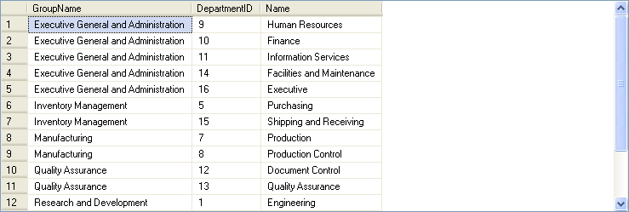
Retrieving Selected Rows (Contd.)
For example:
SELECT GroupName, DepartmentID, Name FROM HumanResources.Department ORDER BY GroupName, DepartmentID
Output
Notes:
Explain the students that when the ORDER BY clause is used, only the output of the SELECT statement is sorted. Stress on that the physical data in the table remains as it is, only the output is sorted. In addition, mention that the default sort order is ASC.
Additional Inputs
Image, text, and ntext columns cannot be used in an ORDER BY clause.
Example: (ASC)
SELECT DepartmentID, Name FROM HumanResources.Department ORDER BY Name ASC

Slide 55
Retrieving Selected Rows (Contd.)
TOP keyword:
Can be used with the SELECT statement to retrieve only the first set of rows from the top of a table.
Syntax:
SELECT [TOP n [PERCENT]] column_name
[,column_name…]
FROM table_name
WHERE search_conditions
[ORDER BY [column_name[,column_name…]
For example:
SELECT TOP 10 * FROM HumanResources.Employee
Retrieves the top 10 rows of the Employee table.
Notes:
Stress that the TOP keyword is used to retrieve the top few records, as they exist in the table. If you require the top few records with respect to a sort order of a particular column, then you need to include the ORDER BY keywords in the SELECT statement.
Additional Input
Unlike previous versions of Microsoft SQL Server, now TOP keyword can also be used with DML statements, such as UPDATE or DELETE.
Example:
SELECT TOP 3 * FROM HumanResources.Employee WHERE HireDate >= '1/1/98' AND HireDate <= '12/31/98' ORDER BY SickLeaveHours ASC

Slide 56
Retrieving Selected Rows (Contd.)
DISTINCT keyword:
Eliminates the duplicate rows from the result set.
Syntax:
SELECT [ALL|DISTINCT] column_names
FROM table_name
WHERE search_condition
For example:
SELECT DISTINCT Title FROM
HumanResources.Employee
WHERE Title LIKE 'PR%'
Retrieves all the titles beginning with PR from the Employee table.
Notes:
Explain the students that when you use more than one column with the DISTINT clause, SQL Server displays you the unique matches of these columns.
Additional Inputs
When using DISTINCT, only the name of a column can be used, an arithmetic expression gives an error.
Example:
SELECT DISTINCT Title FROM HumanResources.Employee WHERE Title LIKE 'PR%'

Slide 57
Just a minute
Write a query to display all the records of the ProductModel table where the product name begins with HL.
Solution:
SELECT * FROM Production.ProductModel WHERE Name LIKE 'HL%'
Notes:
Student already have learnt about type 2 SCDs in Module I. Therefore, you can start this topic by asking the following questions to students:
What are type 2 SCDs?
Given an example to explain type 2 SCDs.
This will recapitulate what they have learnt about type 2 SCD in Module 1.
Now explain the strategy to update the data into these dimension tables with help the example given in SG.
After explaining the examples, you can ask students to think of an example of a type 2 SCD and then tell the strategy to update the data into this dimension table.

Slide 58
Demo: Retrieving Data
Problem Statement:
You are a database developer of AdventureWorks, Inc. The AdventureWorks database is stored in the SQLSERVER01 database server. The details of the sales persons are stored in the SalesPerson table. The management wants to view the details of the top three sales persons who have earned bonus money between $ 4,000 and $ 6,000.
How will you generate this report?
Notes:
Student already have learnt about type 2 SCDs in Module I. Therefore, you can start this topic by asking the following questions to students:
What are type 2 SCDs?
Given an example to explain type 2 SCDs.
This will recapitulate what they have learnt about type 2 SCD in Module 1.
Now explain the strategy to update the data into these dimension tables with help the example given in SG.
After explaining the examples, you can ask students to think of an example of a type 2 SCD and then tell the strategy to update the data into this dimension table.

Slide 59
Demo: Retrieving Data (Contd.)
Solution:
To solve the preceding problem, you need to perform the following tasks:
1. Create a query.
2. Execute the query to generate the report.
Notes:
Student already have learnt about type 2 SCDs in Module I. Therefore, you can start this topic by asking the following questions to students:
What are type 2 SCDs?
Given an example to explain type 2 SCDs.
This will recapitulate what they have learnt about type 2 SCD in Module 1.
Now explain the strategy to update the data into these dimension tables with help the example given in SG.
After explaining the examples, you can ask students to think of an example of a type 2 SCD and then tell the strategy to update the data into this dimension table.

Slide 60
Using Functions to Customize the Result Set
What is customization?

Slide 61
Using Functions to Customize the Result Set (Contd.)
Customization includes changing the format of the string or date values or performing calculations on the numeric values in the result set.
Notes:
Explain customization with the help of examples. The date in the database is stored in the mm\dd\yy format. If you want to display only the month of the date values stored in the database, you need to customize the date values. Similarly, to display total cost of the order, you need to perform calculation on the rate and quantity purchased for the product.

Slide 62
Using Functions to Customize the Result Set (Contd.)
SQL Server provides the following in-built functions to customize the result set:
String functions
Date functions
Mathematical functions
Ranking functions
System functions
Notes:
62
Introduce the various built-in functions used in SQL Server 2005 for customizing the result set.

Slide 63
Using String Functions
String functions:
Are used to manipulate the string values in the result set.
Are used with the char and varchar data types.
Syntax:
SELECT function_name (parameters)
Notes:
Discuss the syntax of using string functions.

Slide 64
Using String Functions (Contd.)
The following table lists some of the string functions provided by SQL Server.
Function name | Parameters | Example | Description
char | (integer_expression) | SELECT char(65) | Returns 'A', the character equivalent of the ASCII code value
left | (character_expression, integer_expression) | SELECT left ('RICHARD',4) | Returns 'RICH', which is a part of the character string equal in size to the integer_expression characters from the left
len | (character_expression) | SELECT len ('RICHARD') | Returns 7, the number of characters in the character_expression
ltrim | (character_expression) | SELECT ltrim (' RICHARD') | Returns 'RICHARD' without leading spaces. It removes leading blanks from the character expression
reverse | (character_expression) | SELECT reverse ('ACTION') | Returns 'NOITCA', the reverse of the character_expression
Notes:
Briefly explain some of the string functions to make students understand about their usage. The slide lists only the frequently used string functions. You can also discuss other string functions given in SG.

Slide 65
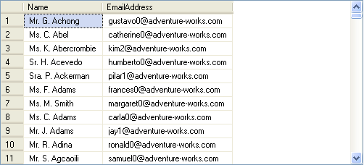
Using String Functions (Contd.)
For example:
SELECT Name = Title + ' ' + left(FirstName,1) + '. ' + LastName, EmailAddress FROM Person.Contact
Output
Notes:
Demonstrate the example given in the slide. You can also demonstrate the usage of the upper() function as given in an example in SG. In addition, demonstrate the additional example given in the Input doc for this session.

Slide 66
Using Date Functions
Date functions are used to manipulate date and time values.
The following table lists some of the date functions provided by SQL Server.
Function name | Parameters | Example | Description
dateadd | (date part, number, date) | SELECT dateadd(mm, 3,’2009-01-01’) | Returns 2009-04-01, adds 3 months to the date
datename | (date part, date) | SELECT datename(month, convert(datetime,'2005-06-06')) | Returns June, date part from the listed date as a character value)
getdate | No Parameters | SELECT getdate() | Returns the current date and time
day | (date) | SELECT day('2009-01-05') | Returns 5, an integer, which represents the day
Notes:
Explain the purpose of using date functions. Then, describe some of the date functions provided by SQL Server 2005. While explaining the datename function, first describe the usage of the convert function. The slide lists only the frequently used date functions. You can also discuss other date functions given in SG.

Slide 67
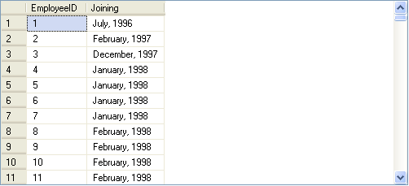
Using Date Functions (Contd.)
The following SQL query uses datename() and datepart() functions to retrieve the month name and year from a given date:
SELECT EmployeeID, datename(mm, hiredate)+ ', ' + convert(varchar, datepart(yyyy, hiredate)) as 'Joining' FROM HumanResources.Employee
Output
Notes:
Demonstrate the example given in the slide. You can use the following query to display the same result as given in the slide:
SELECT EmployeeID,datename(mm, hiredate)+ ', ' + datename(yyyy, hiredate)) as 'Joining'
FROM HumanResources.Employee
Explain that datename function returns value in the form of characters and datepart returns value in the form of integer. However, the concatenation operator (+) concatenates character values only. Therefore, if you use datepart function, you need to convert the value to character format before concatenation. However, if you use datename function, you do not need to use the convert function.
Demonstrate the additional example given in the Input doc for this session.
You can also demonstrate other examples given under the topic “Using Date Functions” in SG.

Slide 68
Using Mathematical Functions
Mathematical functions are used to manipulate the numeric values in a result set.
The following table lists some of the mathematical functions provided by SQL Server.
Function name | Parameters | Example | Description
ceiling | (numeric_expression) | SELECT ceiling(14.45) | Returns 15, the smallest integer greater than or equal to the specified value
exp | (float_expression) | SELECT exp(4.5) | Returns 90.0171313005218, the exponential value of the specified value
floor | (numeric_expression) | SELECT floor(14.45) | Returns14, the largest integer less than or equal to the specified value
power | (numeric_expression, y) | SELECT power(4,3) | Returns 64, which is 4 to the value of 3
round | (numeric_expression, length) | SELECT round(15.789, 2) | Returns 15.790, a numeric expression rounded off to the length specified as an integer expression
Notes:
Explain the purpose of using mathematical functions. Then, describe some of the math functions provided by SQL Server 2005. The slide lists only the frequently used math functions. You can also discuss other math functions given in SG.

Slide 69
Using Mathematical Functions (Contd.)
The following table lists the usage of the round() function provided by SQL Server.
Function | Output
round (1234.567,2) | 1234.570
round (1234.567,1) | 1234.600
round (1234.567,0) | 1235.000
round (1234.567,-1) | 1230.000
round (1234.567,-2) | 1200.000
round (1234.567,-3) | 1000.000
Notes:
Explain the usage of the round() function as provided in the table given in the slide.

Slide 70
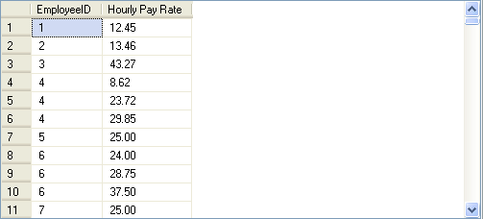
Using Mathematical Functions (Contd.)
The following SQL query retrieves the EmployeeID and Rate for a specified employee id from the EmployeePayHistory table:
SELECT EmployeeID, 'Hourly Pay Rate' = round(Rate,2)
FROM HumanResources.EmployeePayHistory
Output
Notes:
Demonstrate the example given in the slide.

Slide 71
Just a minute
Identify the utility of the datepart() function.
Solution:
The datepart() function is used to extract different parts of a date value.
Notes:
Reiterate the concepts taught earlier by asking the given question.

Slide 72
Just a minute
The management of AdventureWorks wants to increase the shift time from 8 hours to 10 hours. Calculate the end time of the shifts based on their start time.
Solution:
SELECT ShiftID, StartTime, 'EndTime' = dateadd (hh, 10, StartTime) FROM HumanResources.Shift
Notes:
Reiterate the concepts taught earlier by asking the given question.

Slide 73
Using Ranking Functions
What are ranking functions?

Slide 74
Using Ranking Functions (Contd.)
Ranking functions:
Generate sequential numbers for each row or to give a rank based on specific criteria.
Supported by SQL Server are:
row_number()
rank()
dense_ rank()
ntile()
Notes:
74
Student already have learnt about type 2 SCDs in Module I. Therefore, you can start this topic by asking the following questions to students:
What are type 2 SCDs?
Given an example to explain type 2 SCDs.
This will recapitulate what they have learnt about type 2 SCD in Module 1.
Now explain the strategy to update the data into these dimension tables with help the example given in SG.
After explaining the examples, you can ask students to think of an example of a type 2 SCD and then tell the strategy to update the data into this dimension table.

Slide 75
Using Ranking Functions (Contd.)
The row_number() function:
Returns the sequential numbers, starting at 1, for the rows in a result set based on a column.
For example:
SELECT EmployeeID, Rate, row_number() OVER(ORDER BY Rate desc)AS RANK FROM HumanResources.EmployeePayHistory
Notes:
75
Student already have learnt about type 2 SCDs in Module I. Therefore, you can start this topic by asking the following questions to students:
What are type 2 SCDs?
Given an example to explain type 2 SCDs.
This will recapitulate what they have learnt about type 2 SCD in Module 1.
Now explain the strategy to update the data into these dimension tables with help the example given in SG.
After explaining the examples, you can ask students to think of an example of a type 2 SCD and then tell the strategy to update the data into this dimension table.

Slide 76
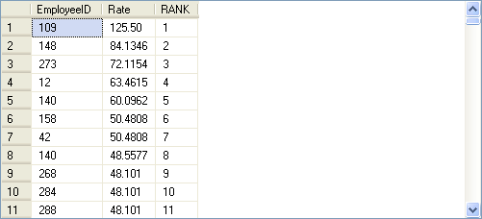
Using Ranking Functions (Contd.)
The following figure displays the output of the preceding query.
Displays the sequential number in a column.
Notes:
76
Student already have learnt about type 2 SCDs in Module I. Therefore, you can start this topic by asking the following questions to students:
What are type 2 SCDs?
Given an example to explain type 2 SCDs.
This will recapitulate what they have learnt about type 2 SCD in Module 1.
Now explain the strategy to update the data into these dimension tables with help the example given in SG.
After explaining the examples, you can ask students to think of an example of a type 2 SCD and then tell the strategy to update the data into this dimension table.

Slide 77
Using Ranking Functions (Contd.)
The rank() function:
Returns the rank of each row in a result set based on specified criteria.
For example:
SELECT EmployeeID, Rate, rank() OVER(ORDER BY Rate desc)AS rank FROM HumanResources.EmployeePayHistory
Notes:
77
Student already have learnt about type 2 SCDs in Module I. Therefore, you can start this topic by asking the following questions to students:
What are type 2 SCDs?
Given an example to explain type 2 SCDs.
This will recapitulate what they have learnt about type 2 SCD in Module 1.
Now explain the strategy to update the data into these dimension tables with help the example given in SG.
After explaining the examples, you can ask students to think of an example of a type 2 SCD and then tell the strategy to update the data into this dimension table.

Slide 78
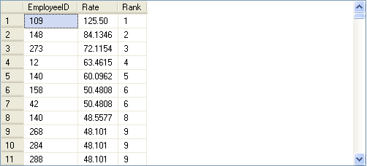
Using Ranking Functions (Contd.)
The following figure displays the output of the preceding query.
The salary rates for the employee IDs 158 and 42 are same.
But the rank for the employee ID 140 is 8, not 7.
Notes:
78
Student already have learnt about type 2 SCDs in Module I. Therefore, you can start this topic by asking the following questions to students:
What are type 2 SCDs?
Given an example to explain type 2 SCDs.
This will recapitulate what they have learnt about type 2 SCD in Module 1.
Now explain the strategy to update the data into these dimension tables with help the example given in SG.
After explaining the examples, you can ask students to think of an example of a type 2 SCD and then tell the strategy to update the data into this dimension table.

Slide 79
Using Ranking Functions (Contd.)
The dense_rank() function:
Is used where consecutive ranking values need to be given based on a specified criteria.
For example:
SELECT EmployeeID, Rate, dense_rank() OVER(ORDER BY Rate desc)AS rank FROM HumanResources.EmployeePayHistory
Notes:
You can summarize the session by running through the summary given in SG.
In addition, you can also ask students summarize what they have learnt in this session.

Slide 80
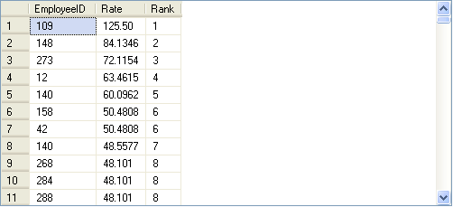
Using Ranking Functions (Contd.)
The following figure displays the output of the preceding query.
The salary rates for the employee IDs 158 and 42 are same.
But the rank for the employee ID 140 is 7, not 8.
Notes:
You can summarize the session by running through the summary given in SG.
In addition, you can also ask students summarize what they have learnt in this session.

Slide 81
Using Ranking Functions (Contd.)
The ntile() function:
Is used to divide the result set into a specific number of groups.
Accepts a positive integer to distribute the rows into the number of groups.
Returns the number of group to which the row belongs for each row retrieved from the database.
For example:
SELECT EmployeeID, BirthDate, HireDate, ntile(4) OVER(ORDER BY BirthDate) AS Rank
FROM HumanResources.Employee
WHERE datepart(mm, HireDate) >= 04 AND datepart(yy, HireDate) >= 2001
Notes:
You can summarize the session by running through the summary given in SG.
In addition, you can also ask students summarize what they have learnt in this session.

Slide 82
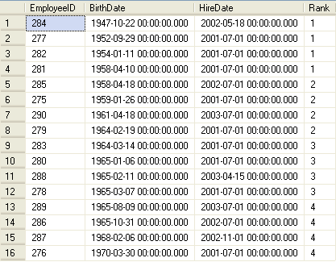
Using Ranking Functions (Contd.)
The following figure displays the output of the preceding query.
Divided into four groups with each group containing four rows and each row in a group is given the same ranking.
Notes:
You can summarize the session by running through the summary given in SG.
In addition, you can also ask students summarize what they have learnt in this session.

Slide 83
Using System Functions
System functions:
Are used to query the system tables.
Are used to access the SQL Server databases or user-related information.
For example:
SELECT host_id() as ‘HostID’
Displays the host ID of the terminal on which you are logged onto.
Notes:
You can summarize the session by running through the summary given in SG.
In addition, you can also ask students summarize what they have learnt in this session.

Slide 84
Using System Functions (Contd.)
The following table lists some of the system functions provided by SQL Server.
Function | Definition | Example
host_name () | Returns the current host computer name of a client process. | SELECT host_name() AS 'HostName'
suser_sid ([‘login_name’]) | Returns the security identification (SID) number corresponding to the log on name of the user. | SELECT suser_sid ('sa') AS SID
user_id ([‘name_in_db’]) | Returns the database identification number corresponding to the user name. | SELECT user_id ('Robert') AS USERID
db_id (['db_name']) | Returns the database identification number of the database. | SELECT db_id('AdventureWorks') AS DatabaseID
db_name ([db_id]) | Returns the database name. | SELECT db_name(17) AS DatabaseName
object_id (‘objname’) | Returns the database object ID number. | SELECT object_id ('AdventureWorks.HumanResources.Employee') AS ObjectID
Notes:
You can summarize the session by running through the summary given in SG.
In addition, you can also ask students summarize what they have learnt in this session.

Slide 85
Demo: Customizing the Result Set
Problem Statement:
The management at AdventureWorks, Inc. wants to view a report that displays the employee ID, designation, and age of the employees who are working as marketing managers or marketing specialists. The data should be displayed in uppercase.
The employee details are stored in the Employee table in the AdventureWorks database. How will you display the required data?
Notes:
You can summarize the session by running through the summary given in SG.
In addition, you can also ask students summarize what they have learnt in this session.

Slide 86
Demo: Customizing the Result Set (Contd.)
Solution:
To solve the preceding problem, you need to perform the following tasks:
Create a query.
Execute the query to display the data.
Notes:
You can summarize the session by running through the summary given in SG.
In addition, you can also ask students summarize what they have learnt in this session.

Slide 87
Summarizing and Grouping Data
How can I summarize and group data?

Slide 88
Summarizing and Grouping Data (Contd.)
SQL Server provides aggregate functions to generate summarized data.
Notes:
88
Student already have learnt about type 2 SCDs in Module I. Therefore, you can start this topic by asking the following questions to students:
What are type 2 SCDs?
Given an example to explain type 2 SCDs.
This will recapitulate what they have learnt about type 2 SCD in Module 1.
Now explain the strategy to update the data into these dimension tables with help the example given in SG.
After explaining the examples, you can ask students to think of an example of a type 2 SCD and then tell the strategy to update the data into this dimension table.

Slide 89
Summarizing Data by Using Aggregate Functions
Aggregate functions:
Summarize the values for a column or a group of columns, and produce a single value.
Syntax:
SELECT aggregate_function([ALL|DISTINCT] expression) FROM table_name
Notes:
89
Student already have learnt about type 2 SCDs in Module I. Therefore, you can start this topic by asking the following questions to students:
What are type 2 SCDs?
Given an example to explain type 2 SCDs.
This will recapitulate what they have learnt about type 2 SCD in Module 1.
Now explain the strategy to update the data into these dimension tables with help the example given in SG.
After explaining the examples, you can ask students to think of an example of a type 2 SCD and then tell the strategy to update the data into this dimension table.

Slide 90
Summarizing Data by Using Aggregate Functions (Contd.)
You can calculate summary values by using the following aggregate functions:
Avg()
Count()
Min()
Max()
Sum()
Notes:
90
Student already have learnt about type 2 SCDs in Module I. Therefore, you can start this topic by asking the following questions to students:
What are type 2 SCDs?
Given an example to explain type 2 SCDs.
This will recapitulate what they have learnt about type 2 SCD in Module 1.
Now explain the strategy to update the data into these dimension tables with help the example given in SG.
After explaining the examples, you can ask students to think of an example of a type 2 SCD and then tell the strategy to update the data into this dimension table.

Slide 91
Summarizing Data by Using Aggregate Functions (Contd.)
Avg():
Returns the average of values in a numeric expression, either all or distinct.
For example:
SELECT 'Average Rate' = avg (Rate) FROM HumanResources.EmployeePayHistory
Count():
Returns the number of values in an expression, either all or distinct.
For example:
SELECT 'Unique Rate' = count (DISTINCT Rate) FROM HumanResources.EmployeePayHistory
Notes:
91
Student already have learnt about type 2 SCDs in Module I. Therefore, you can start this topic by asking the following questions to students:
What are type 2 SCDs?
Given an example to explain type 2 SCDs.
This will recapitulate what they have learnt about type 2 SCD in Module 1.
Now explain the strategy to update the data into these dimension tables with help the example given in SG.
After explaining the examples, you can ask students to think of an example of a type 2 SCD and then tell the strategy to update the data into this dimension table.

Slide 92
Summarizing Data by Using Aggregate Functions (Contd.)
Min():
Returns the lowest value in the expression.
For example:
SELECT 'Minimum Rate' = min (Rate) FROM HumanResources.EmployeePayHistory
Max():
Returns the highest value in the expression.
For example:
SELECT 'Maximum Rate' = max (Rate) FROM HumanResources.EmployeePayHistory
Sum():
Returns the sum total of values in a numeric expression, either all or distinct.
For example:
SELECT 'Sum' = sum (DISTINCT Rate) FROM HumanResources.EmployeePayHistory
Notes:
92
Student already have learnt about type 2 SCDs in Module I. Therefore, you can start this topic by asking the following questions to students:
What are type 2 SCDs?
Given an example to explain type 2 SCDs.
This will recapitulate what they have learnt about type 2 SCD in Module 1.
Now explain the strategy to update the data into these dimension tables with help the example given in SG.
After explaining the examples, you can ask students to think of an example of a type 2 SCD and then tell the strategy to update the data into this dimension table.

Slide 93
Just a minute
What would be the output of the following query?
SELECT 'Maximum Rate' = max (UnitPrice)
FROM Sales.SalesOrderDetail
Solution:
The query displays the maximum unit price from the SalesOrderDetail table.
Notes:
93
Student already have learnt about type 2 SCDs in Module I. Therefore, you can start this topic by asking the following questions to students:
What are type 2 SCDs?
Given an example to explain type 2 SCDs.
This will recapitulate what they have learnt about type 2 SCD in Module 1.
Now explain the strategy to update the data into these dimension tables with help the example given in SG.
After explaining the examples, you can ask students to think of an example of a type 2 SCD and then tell the strategy to update the data into this dimension table.

Slide 94
Grouping Data
You can group the data by using the GROUP BY, COMPUTE, COMPUTE BY, and PIVOT clauses of the SELECT statement.
Notes:
94
Student already have learnt about type 2 SCDs in Module I. Therefore, you can start this topic by asking the following questions to students:
What are type 2 SCDs?
Given an example to explain type 2 SCDs.
This will recapitulate what they have learnt about type 2 SCD in Module 1.
Now explain the strategy to update the data into these dimension tables with help the example given in SG.
After explaining the examples, you can ask students to think of an example of a type 2 SCD and then tell the strategy to update the data into this dimension table.

Slide 95
Grouping Data (Contd.)
The GROUP BY clause:
Summarizes the result set into groups as defined in the SELECT statement by using aggregate functions.
Uses the HAVING clause to further restrict the result set to produce the data based on a condition.
Syntax:
SELECT column_list
FROM table_name
WHERE condition
[GROUP BY [ALL] expression [, expression]
[HAVING search_condition]
Notes:
95
Student already have learnt about type 2 SCDs in Module I. Therefore, you can start this topic by asking the following questions to students:
What are type 2 SCDs?
Given an example to explain type 2 SCDs.
This will recapitulate what they have learnt about type 2 SCD in Module 1.
Now explain the strategy to update the data into these dimension tables with help the example given in SG.
After explaining the examples, you can ask students to think of an example of a type 2 SCD and then tell the strategy to update the data into this dimension table.

Slide 96
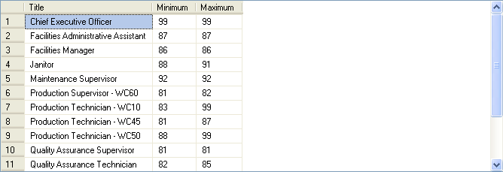
Grouping Data (Contd.)
For example:
SELECT Title, Minimum = min(VacationHours), Maximum = max(VacationHours) FROM HumanResources.Employee WHERE VacationHours > 80 GROUP BY Title
Output
Displays the minimum and maximum values of vacation hours for the different types of titles.
Notes:
96
Student already have learnt about type 2 SCDs in Module I. Therefore, you can start this topic by asking the following questions to students:
What are type 2 SCDs?
Given an example to explain type 2 SCDs.
This will recapitulate what they have learnt about type 2 SCD in Module 1.
Now explain the strategy to update the data into these dimension tables with help the example given in SG.
After explaining the examples, you can ask students to think of an example of a type 2 SCD and then tell the strategy to update the data into this dimension table.

Slide 97
Grouping Data (Contd.)
The GROUPING SETS clause is used to combine the result generated by multiple GROUP BY clauses into a single result set.
For example:
SELECT Region, Department, AVG(SAL)
AverageSalary FROM EmpTable
GROUP BY
GROUPING SETS
(
(Region, Department),
(Region),
(Department)
)
Notes:
97
Student already have learnt about type 2 SCDs in Module I. Therefore, you can start this topic by asking the following questions to students:
What are type 2 SCDs?
Given an example to explain type 2 SCDs.
This will recapitulate what they have learnt about type 2 SCD in Module 1.
Now explain the strategy to update the data into these dimension tables with help the example given in SG.
After explaining the examples, you can ask students to think of an example of a type 2 SCD and then tell the strategy to update the data into this dimension table.

Slide 98
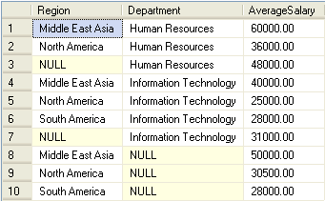
Grouping Data (Contd.)
The following figure displays the output of the preceding query.
The rows that do not have NULL values represent the average salary of the employees grouped for each region and department.
The rows that contain NULL values in the Department column represent the average salary of the employees for each region.
The rows that contain NULL values in the Region column represent the average salary of the employees for each department.
Notes:
98
Student already have learnt about type 2 SCDs in Module I. Therefore, you can start this topic by asking the following questions to students:
What are type 2 SCDs?
Given an example to explain type 2 SCDs.
This will recapitulate what they have learnt about type 2 SCD in Module 1.
Now explain the strategy to update the data into these dimension tables with help the example given in SG.
After explaining the examples, you can ask students to think of an example of a type 2 SCD and then tell the strategy to update the data into this dimension table.

Slide 99
Grouping Data (Contd.)
COMPUTE and COMPUTE BY:
The COMPUTE clause is used to generate summary rows by using aggregate functions in the query results.
The COMPUTE BY clause can be used to calculate summary values of the result set on a group of data.
Syntax:
SELECT column_list
FROM table_name
ORDER BY column_name
COMPUTE aggregate_function (column_name) [, aggregate_function (column_name)...] [BY column_name [, column_name]...]
Notes:
99
Student already have learnt about type 2 SCDs in Module I. Therefore, you can start this topic by asking the following questions to students:
What are type 2 SCDs?
Given an example to explain type 2 SCDs.
This will recapitulate what they have learnt about type 2 SCD in Module 1.
Now explain the strategy to update the data into these dimension tables with help the example given in SG.
After explaining the examples, you can ask students to think of an example of a type 2 SCD and then tell the strategy to update the data into this dimension table.

Slide 100
Grouping Data (Contd.)
For example:
SELECT Title, 'Total VacationHours' = VacationHours, 'Total SickLeaveHours' = SickLeaveHours FROM HumanResources.Employee WHERE Title IN ('Recruiter', 'Stocker') ORDER BY Title, VacationHours, SickLeaveHours COMPUTE SUM(VacationHours), SUM(SickLeaveHours
Notes:
You can summarize the session by running through the summary given in SG.
In addition, you can also ask students summarize what they have learnt in this session.

Slide 101
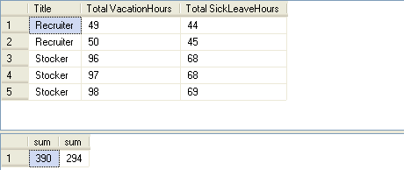
Grouping Data (Contd.)
The following figure displays the output of the preceding query.
Notes:
You can summarize the session by running through the summary given in SG.
In addition, you can also ask students summarize what they have learnt in this session.

Slide 102
Grouping Data (Contd.)
The PIVOT clause:
Is used to transform a set of columns into values.
Rotates a table-valued expression by turning the unique values from one column in the expression into multiple columns in the output.
Syntax:
SELECT * from table_name
PIVOT (aggregation_function (value_columhe)
FOR pivot_column
IN (column_list)
) table_alias
Notes:
You can summarize the session by running through the summary given in SG.
In addition, you can also ask students summarize what they have learnt in this session.

Slide 103
Grouping Data (Contd.)
For example:
SELECT VendorID, [164] AS Emp1, [198] AS Emp2, [223] AS Emp3, [231] AS Emp4, [233] AS Emp5
FROM
(SELECT PurchaseOrderID, EmployeeID, VendorID
FROM Purchasing.PurchaseOrderHeader) p
PIVOT
(
COUNT (PurchaseOrderID)
FOR EmployeeID IN
( [164], [198], [223], [231], [233] )
) AS pvt
ORDER BY VendorID
Notes:
You can summarize the session by running through the summary given in SG.
In addition, you can also ask students summarize what they have learnt in this session.

Slide 104
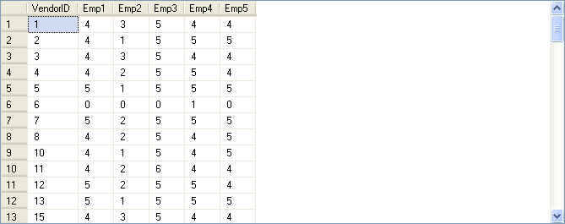
Grouping Data (Contd.)
The following figure displays the output of the preceding query.
Displays the number of purchase orders placed by certain employees, laid down with the vendors.
Notes:
You can summarize the session by running through the summary given in SG.
In addition, you can also ask students summarize what they have learnt in this session.

Slide 105
Just a minute
When grouping data, which of the following clauses helps eliminate the groups that do not match the specified condition?
NOT IN
HAVING
WHERE
COMPUTE
Solution:
2. HAVING
Notes:
You can summarize the session by running through the summary given in SG.
In addition, you can also ask students summarize what they have learnt in this session.

Slide 106
Just a minute
Match the column A with column B.
Column A | Column B
COMPUTE | Transforms a set of columns into values.
PIVOT | Removes leading blanks from the character expression.
Str | Generates summary rows by using aggregate functions in the query results.
Ltrim | Converts numeric data to character data.
Solution:
Column A | Column B
COMPUTE | Generates summary rows by using aggregate functions in the query results.
PIVOT | Transforms a set of columns into values.
Str | Converts numeric data to character data.
Ltrim | Removes leading blanks from the character expression.
Notes:
You can summarize the session by running through the summary given in SG.
In addition, you can also ask students summarize what they have learnt in this session.

Slide 107
Demo: Summarizing and Grouping Data
Problem Statement:
You are a database developer at AdventureWorks, Inc. The management wants to view the average quantity ordered for each product group. The data should be displayed in the descending order of ProductID.
The sales details are stored in the SalesOrderHeader and SalesOrderDetails tables in the AdventureWorks database. How will you generate this report?
Notes:
You can summarize the session by running through the summary given in SG.
In addition, you can also ask students summarize what they have learnt in this session.

Slide 108
Demo: Summarizing and Grouping Data (Contd.)
Solution:
To solve the preceding problem, you need to perform the following tasks:
Create a query.
Execute the query to verify the result.
Notes:
You can summarize the session by running through the summary given in SG.
In addition, you can also ask students summarize what they have learnt in this session.

